Slide 1

CAP 6317/4773: Social Media Mining
Lecture 5: Node Importance
Raiyan Abdul Baten, Ph.D.
January 23, 2024

Slide 2
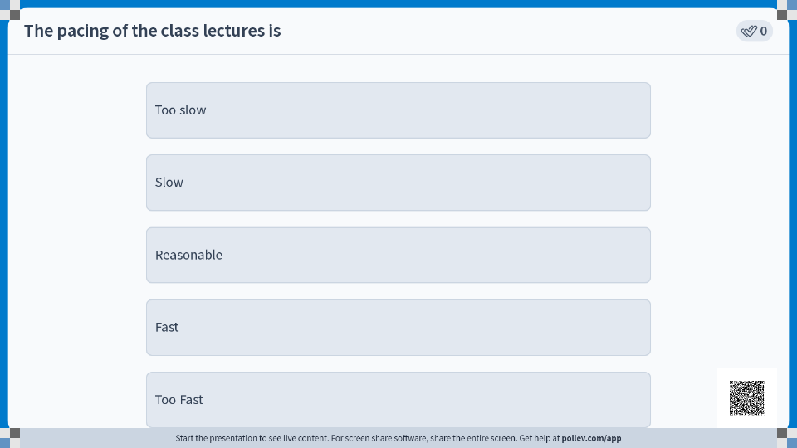

Slide 3
Recap

Slide 4
Social Science
Network/computational Science
Let us not forget
Computer science
Machine learning
Ethnography
Mathematics
Optimization
And more!
Social Media Mining
Statistics and Data Mining

Slide 5
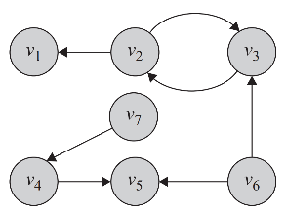
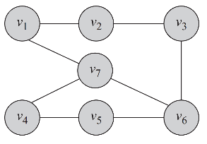
Undirected Graph
Directed Graph
Facebook friends
Members of the same facebook group/subreddit
Co-located in the same zip code
Co-authored a paper
Twitter follower/followee
Cited the other person’s paper
Took creative inspiration from another person
Gave another person feedback

Slide 6
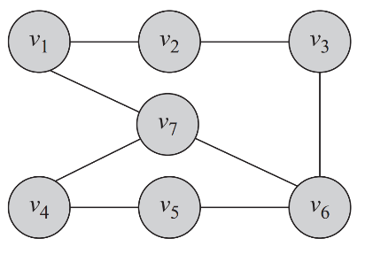



e₁
e₂
e₃
e₈
e₅
e₄
e₆
e₇
G(V,E) denotes our undirected graph, where V is the set of nodes and E is the set of edges
|V| and |E| denote sizes of the respective node and edge sets

Slide 7
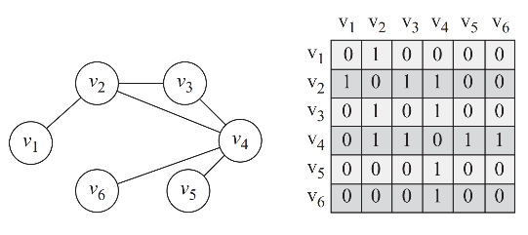
Adjacency Matrix
A 2D matrix, A, with rows and columns denoting nodes
A value of 1 in position A_{i,j} denotes that v_{i} is connected to v_{j}
All other entries are 0

Slide 8
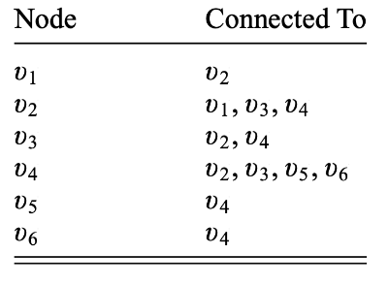
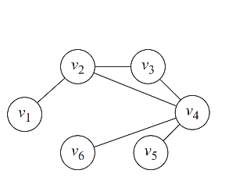
Adjacency List

Slide 9
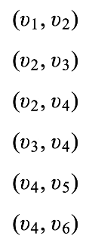
Edge List

Slide 10
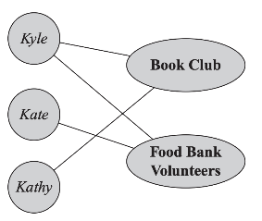
Bipartite Graphs

Slide 11
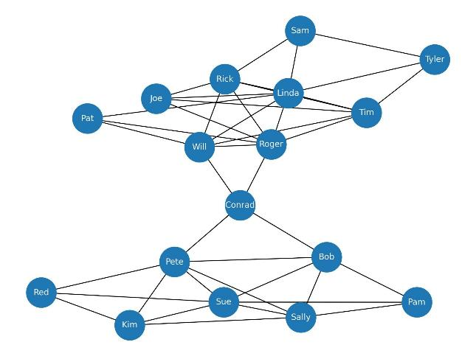
Data collected by Prof. David Krackhardt of Carnegie Mellon University

Slide 12
Summary of Degree Centralities
Undirected graph: Ax1
Directed graph, out-degree centralities: Ax1
Directed graph, in-degree centralities: A^{T}x1
Where A denotes the adjacency matrix of dimension (nxn), and 1 represents a vector of all 1’s of dimension n.

Slide 13
Key Intuition behind Eigenvectors
λx = Ax
If we encounter a real life problem that can be expressed in the format λx = Ax, it will tells us that there are certain special choices of x (associated with A) that will only be scaled by a scalar factor λ and will not get rotated when operated on by A. Those special choice vectors are the Eigenvectors x. The matrix A determines what these Eigenvectors and Eigenvalues will be. In other words, if we know A, we can compute x and λ so that λx = Ax holds.

Slide 14
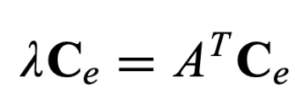
Looks like our problem can be expressed in the λx = Ax format
The equation tells us that for certain special choices of c_{e}, the operator matrix (A^{T} in this case) will not rotate this vector c_{e}, rather only scale it by a factor of λ.
We know how to compute this vector c_{e} when we know the operator matrix! Use linear algebra wizardry. We get the Eigenvector Centrality for each node.

Slide 15
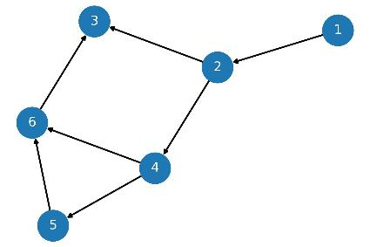
Intuitively, who should be the most influential node in this scenario?
Based on the way we defined importance, everyone ‘gets’ influence from their incoming edges. This also means, your entire influence ‘flows’ outward to every node you point to. Therefore, any node you point to will have at least the same or more influence than you. Node 3 seems to be the most influential here, while node 1 is the least influential.
The problem is, node 1 has no defined influence to begin with, since no one points toward it.

Slide 16
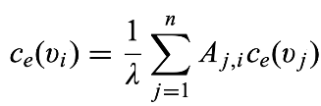
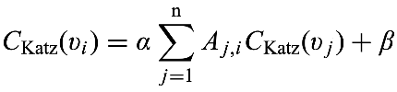

Intuition: Give everyone some ‘free’ centrality
Eigenvector Centrality:
Katz Centrality:
Let’s give everyone some free centrality, for mathematical convenience. Now node 1 in the previous example will have some ‘inherent’ centrality to begin with. That influence will ‘flow’ to the next node(s).

Slide 17

The problem in web search: Giant Hubs
Internet directory hubs like Yahoo have a huge number of incoming and outgoing links
Lots of important incoming links make Yahoo very important == Fair
But every website Yahoo enlists now become very important == Yikes

Slide 18
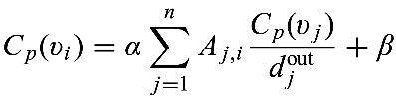
Intuition: Account for the volume of outgoing links
Katz Centrality:
PageRank Centrality:
Normalize by how many links come out of j. In essence, j’s centrality is divided among the outgoing links

Slide 19
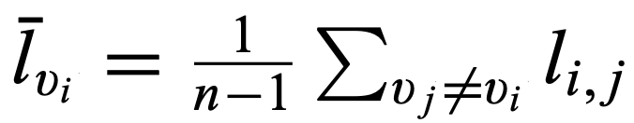
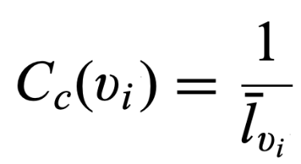
Take the inverse so that low average distances lead to high centrality values

Slide 20
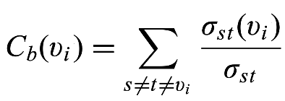
Total number of shortest paths between s and t nodes that go through node v_{i}
Total number of shortest paths between s and t nodes

Slide 21
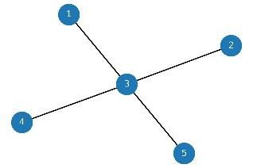

We still need to normalize by the maximum betweenness value that a node in a graph if the same size can possibly take.
We get the maximum betweenness from a Star Graph which has the same number of nodes as our actual graph. In a star graph, the shortest paths between every pair of non-central nodes must go through the central node, so the central node plays the broker role with the most betweenness centrality.
The number of paths that go through the center is = 6
Unnormalized sums
0 | 0 | 5 | 0 | 0
Normalized sums
0/6 | 0/6 | 5/6 | 0/6 | 0/6
These are the betweenness centrality values of each node!

Slide 22
Essentials
Communities and Interactions
Applications
Graph essentials
Network measures
Network models
Community detection
Information diffusion
Social Influence
Recommendation engines
Behavior analysis
Who are the most important people in the network?
How do people befriend others?
How can we find interesting patterns in user-generated content?
How can we identify communities in a social network?
How far can an article be transmitted in a social network?
How can we measure the influence of individuals in a social network?
How can we recommend content or friends to individuals online?

Slide 23
Questions?

Slide 24
Pop Quiz

Slide 25
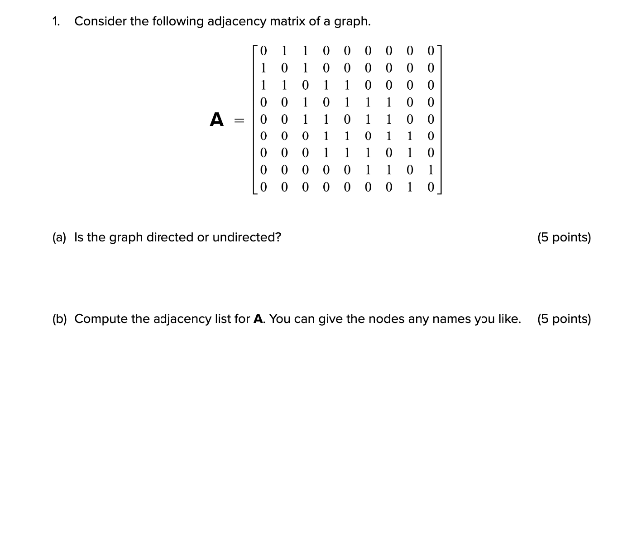

Slide 26
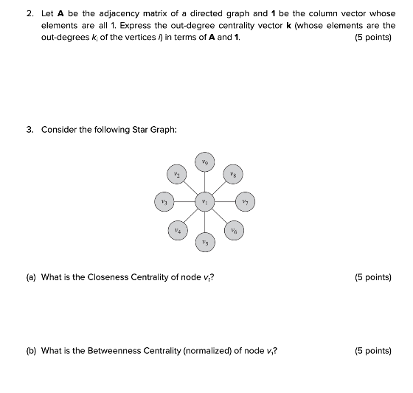

Slide 27
BFS and DFS

Slide 28
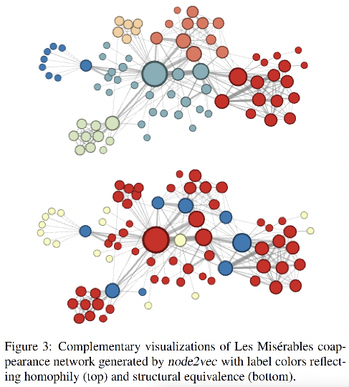
Which nodes are similar to each other?

Slide 29
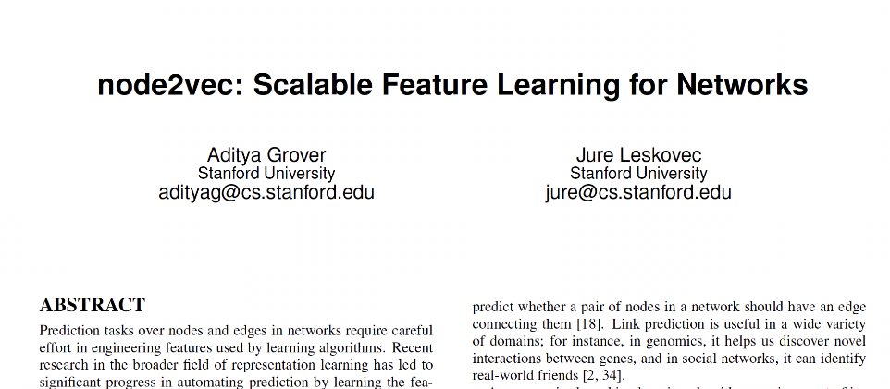

Slide 30
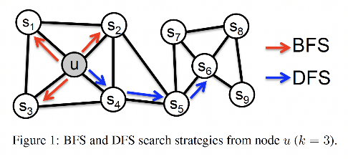
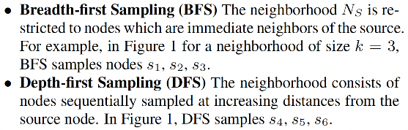

Slide 31
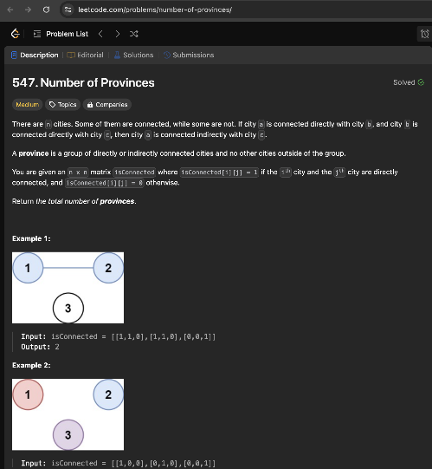

Slide 32
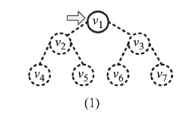

Slide 33
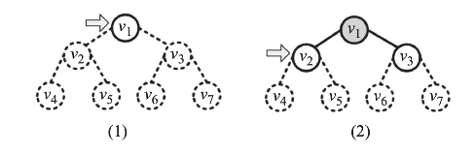

Slide 34
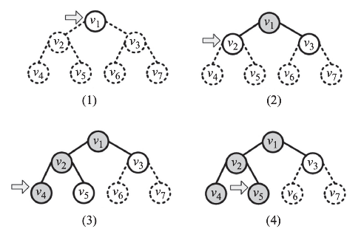

Slide 36
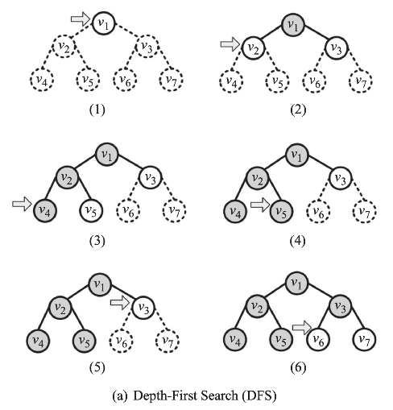

Slide 38
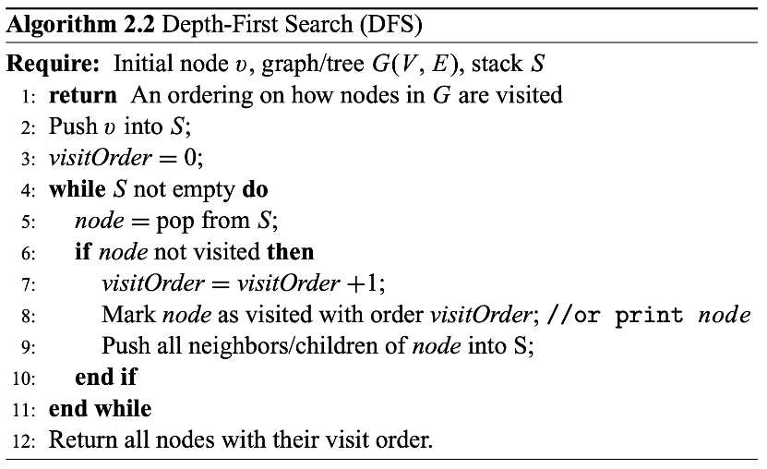

Slide 39
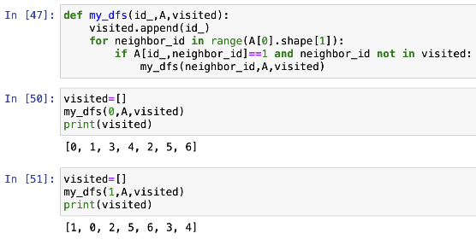
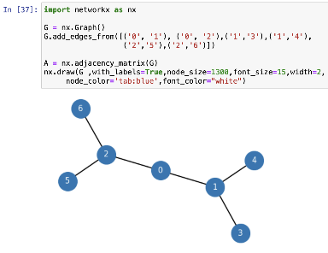

Slide 40
Mark as visited

Slide 41
Visit each peer and recursively call my_dfs()

Slide 42
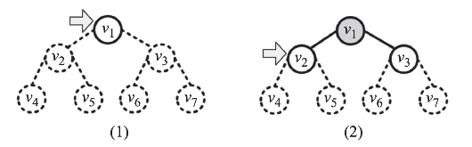

Slide 43
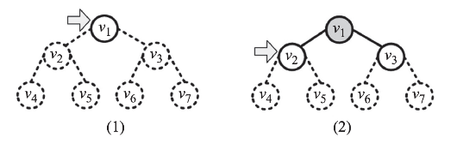

Slide 44
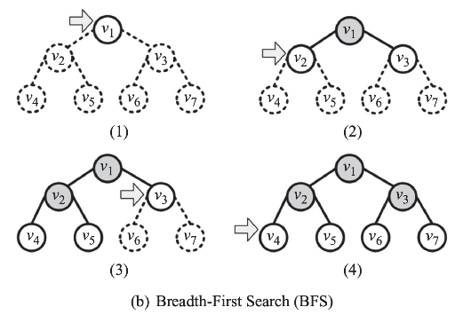

Slide 46
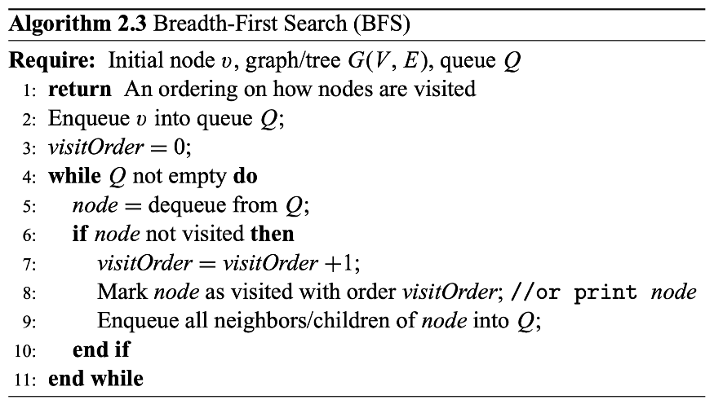

Slide 47
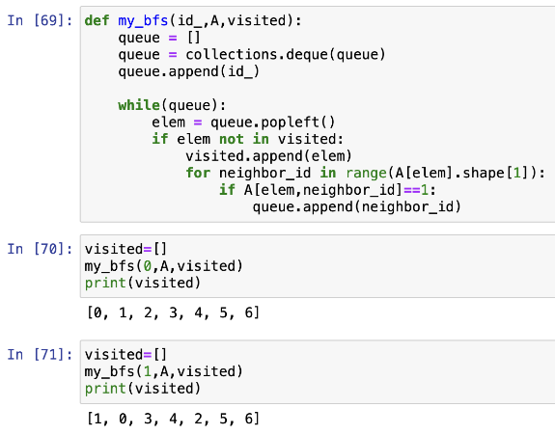


Slide 48
The root node gets appended to the queue

Slide 49
Pop the queue, check if the resulting node has been visited. If not, mark it as visited, and push all of its peers to the queue

Slide 51
Summary

